Slide 1
Controls & Vacuum hands - on training
Vít Machanec, FEL CTU in Prague, Czech Republic
Julius Backai, FEI TU in Kosice, Slovakia
Supervizors: Roman Pivin, Mikhail Nozdrin

Slide 2
Structure of our training
Introduction to PLC, basic electronics and software
Test project – clinic
Vacuum training
Main project – remote control & automatization of vacuum system

Slide 3
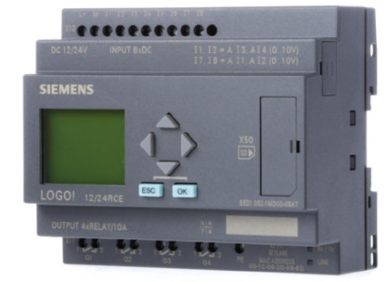
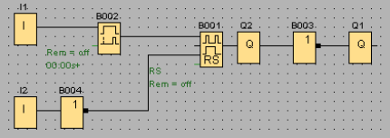
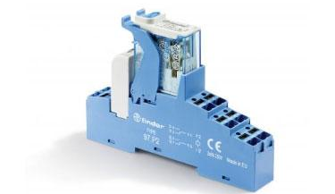
Clinic - test project
Electrical scheme
Siemens LOGO! 24RCE
Logical scheme in LOGO! Soft Comfort V7.0
Relay

Slide 4
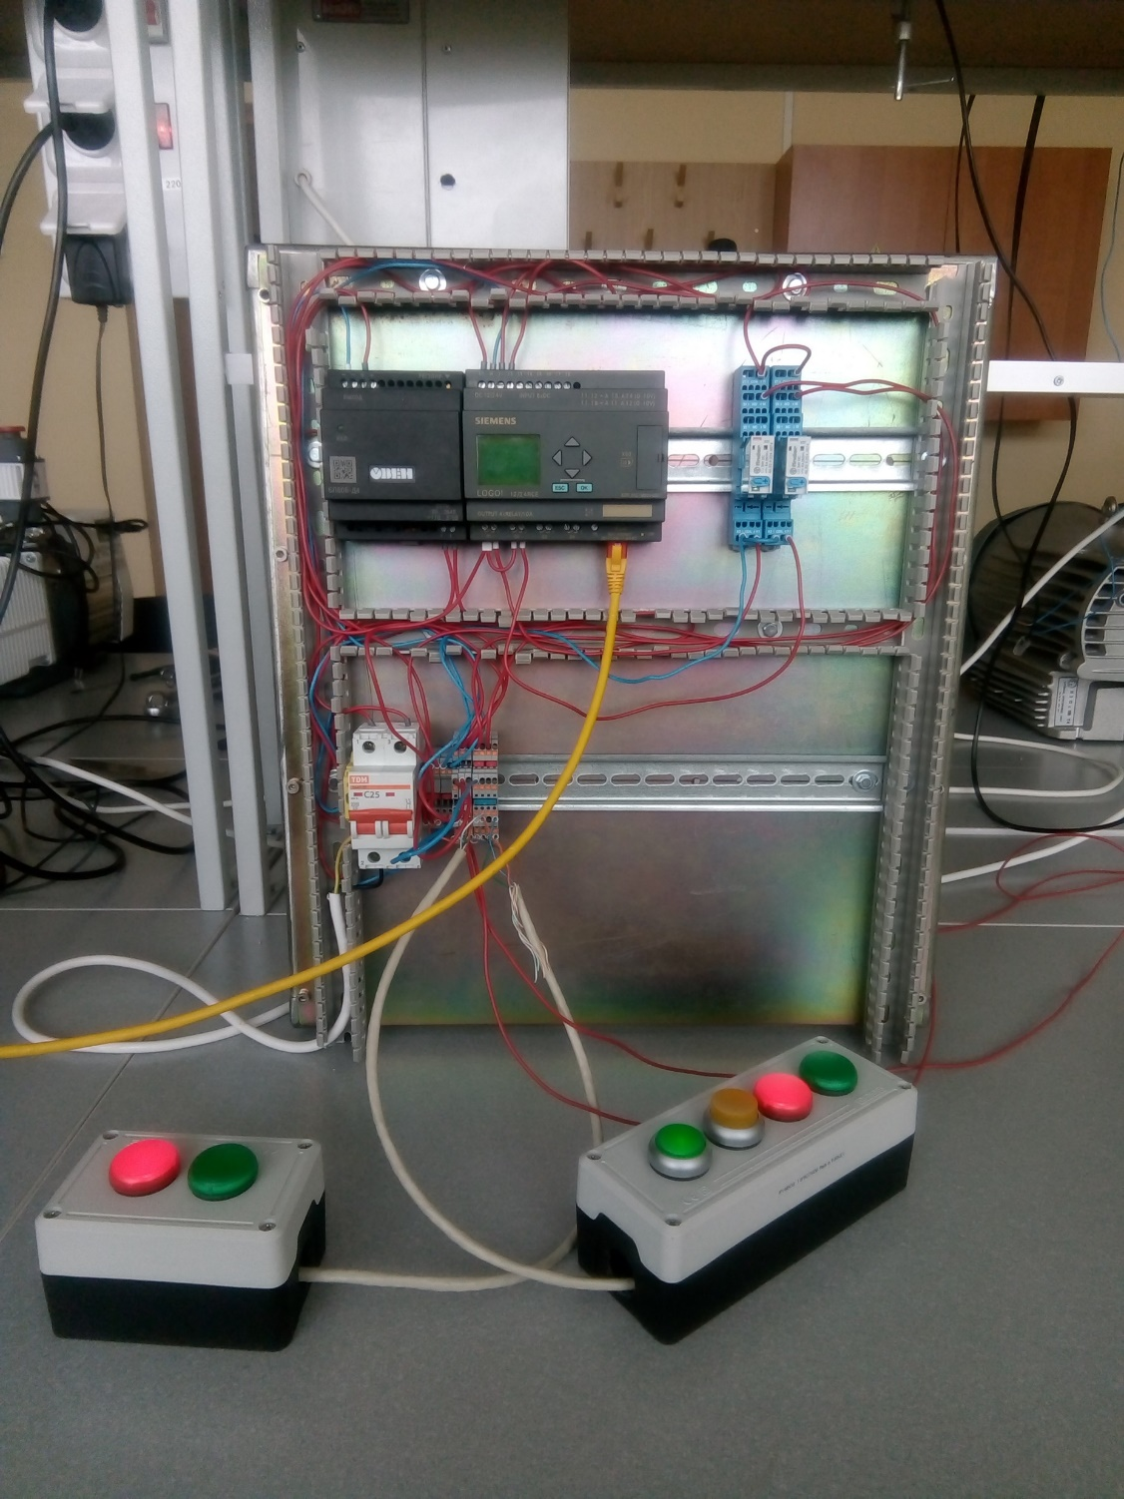
Clinic - test project
Initial state occupied – red lamps lightening
One button pressing changes state to free – red lamps off, green lamps lightening
Next button pressing switches state to opposite
If doors are opened system switches to occupied state
Assembled project

Slide 5
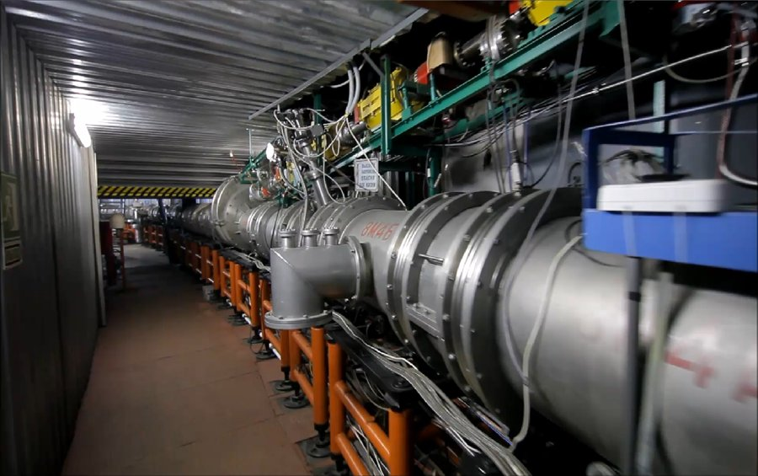
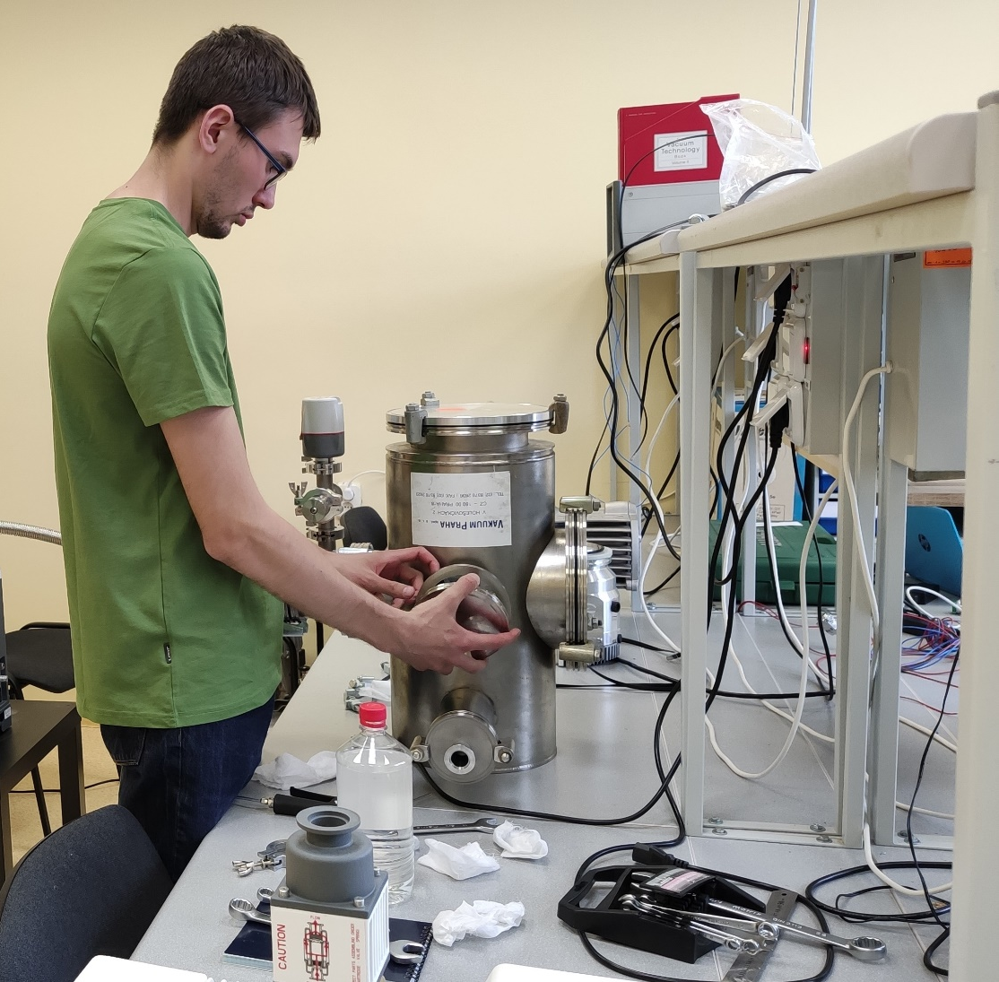
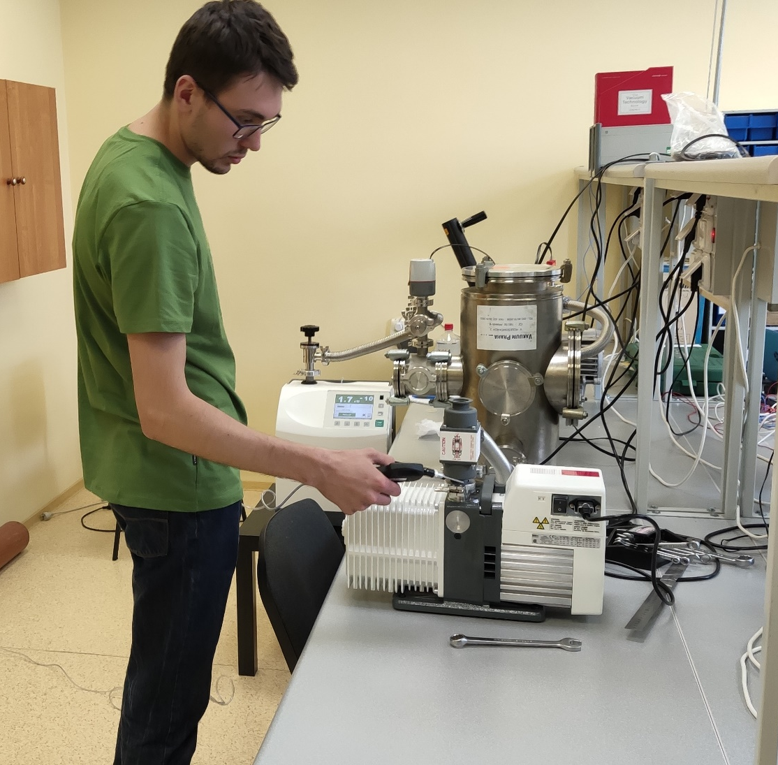
Vacuum training
Visit to the Accelerator Nuclotron - motivation for main project
Assembling the vacuum system in laboratory
Leak detection

Slide 6
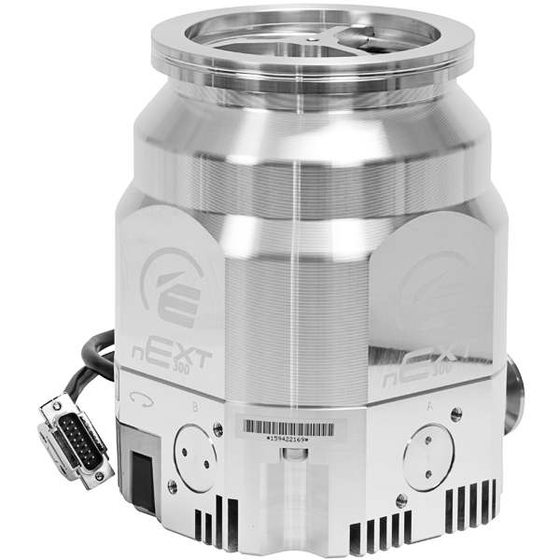
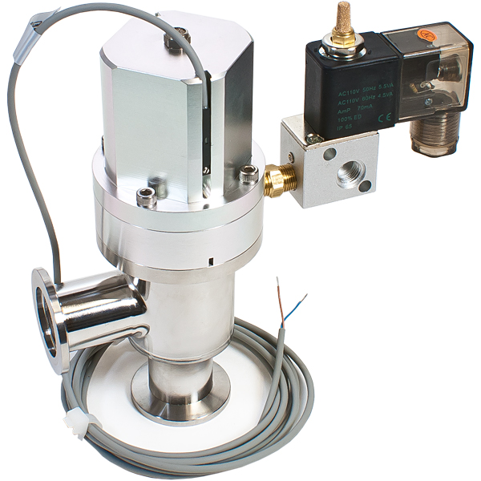
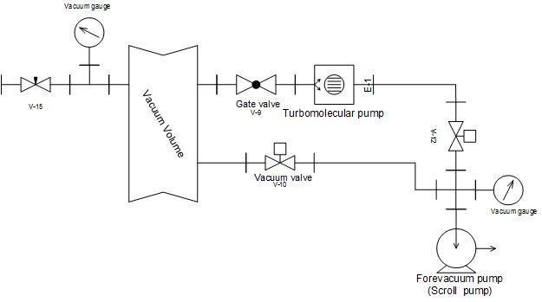
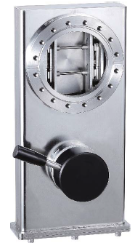
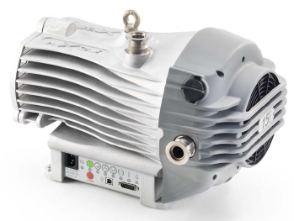
Vacuum training
Vacuum scheme & equipment
Turbomolecular
pump
Angle
valve
Forevacuum pump
Gate valve

Slide 7
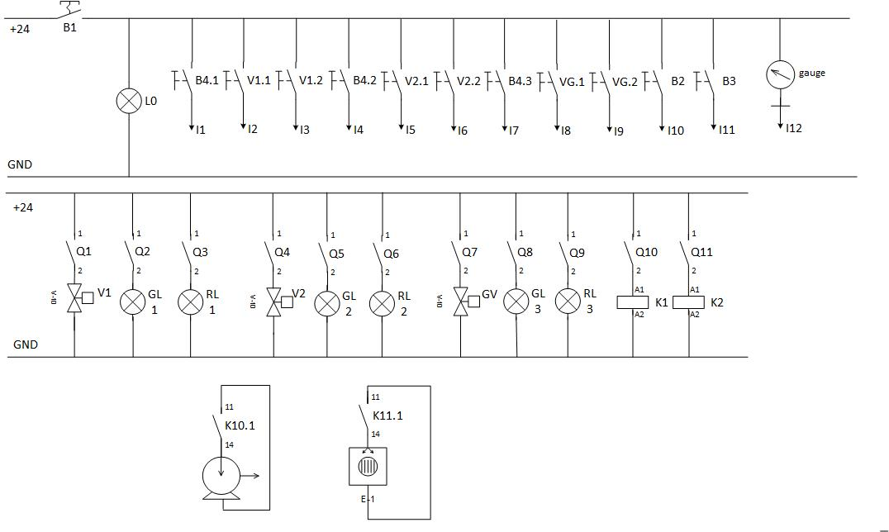
Main project
Project documentation
Electrical scheme
Electrical drawing of test project

Slide 8
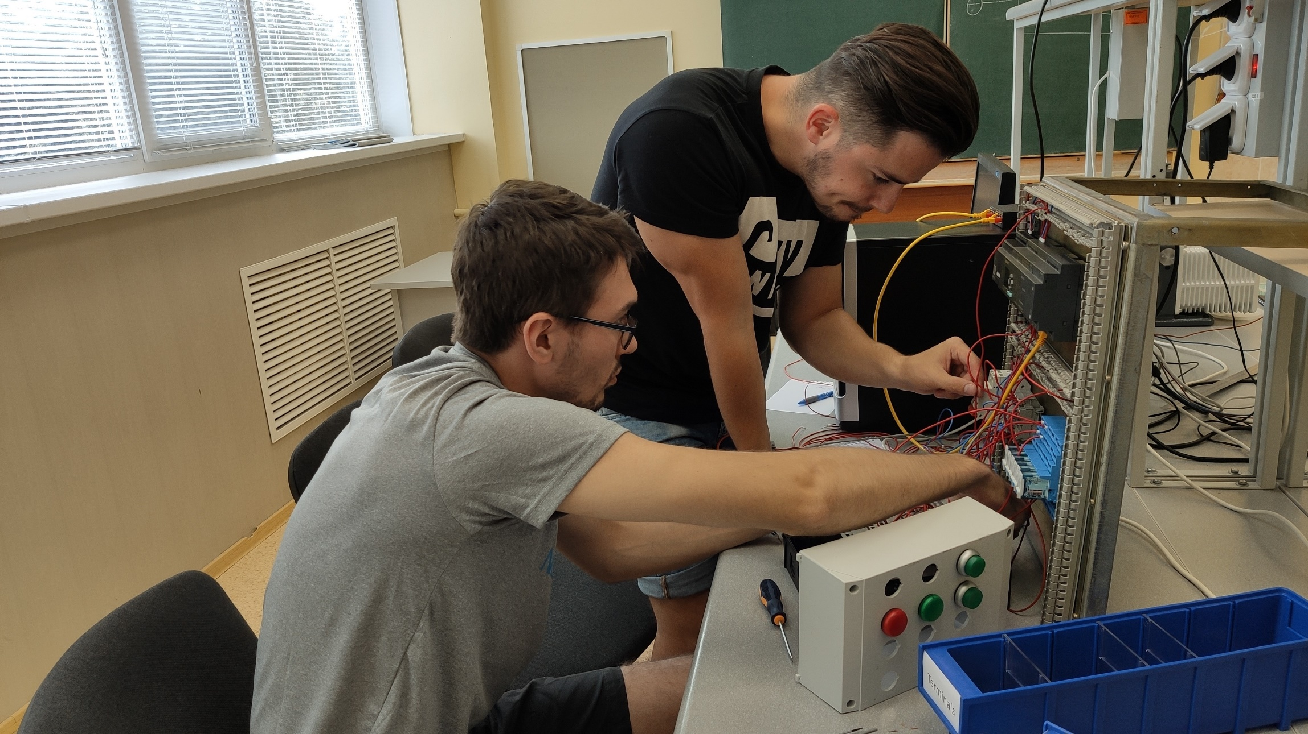
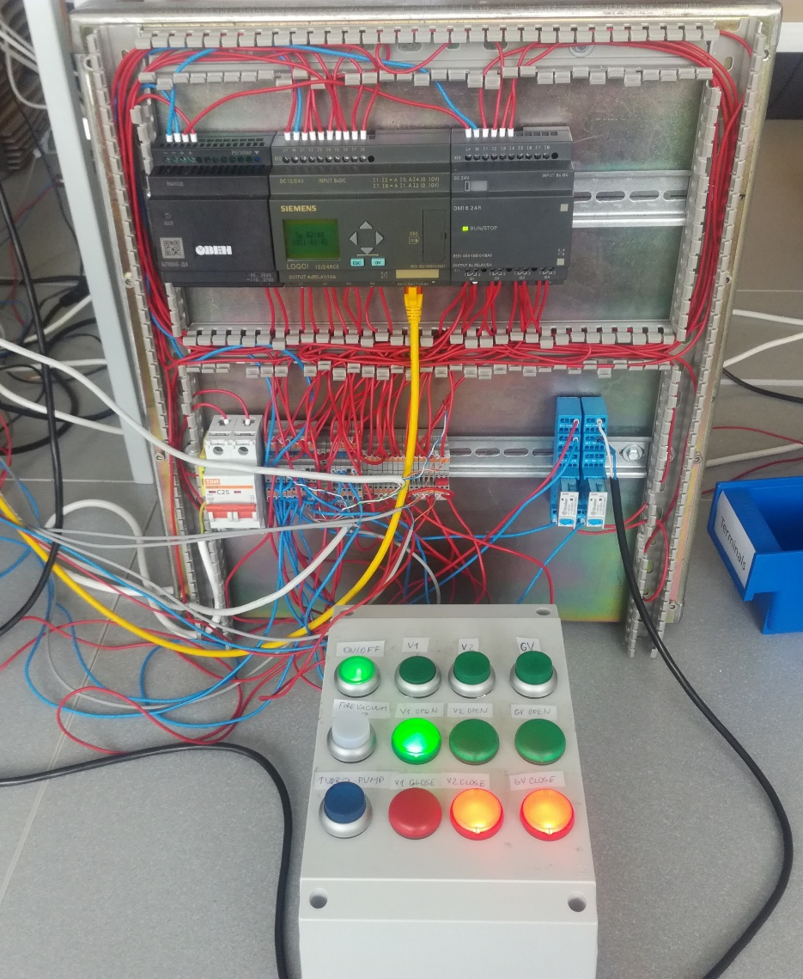
Main project
Change valves
Assembling electrical scheme

Slide 9
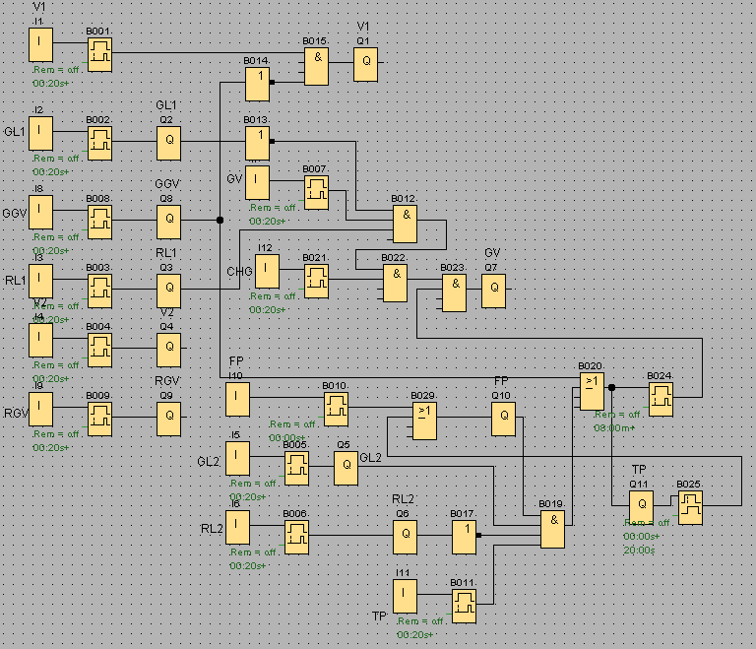
Main project
Testing the system
Interlocks – safety mechanisms
to protect the system
Automatization of the system
Testing
Interlocks
Test project

Slide 10
Conclusion
Learning & practice with PLC and basic electronic components
Understanding & assembling vacuum system
Design of electrical circuits & remote control of vacuum equipment
Programming safety mechanisms
Possible improvements – full automatization

Slide 11
Thank you for your attention

